Slide 1


DataFest
Featuring Sam’s Fans
Mandy (Whalen) McGlone ‘95
Associate Director at Sam’s Fans
Notes:
Good afternoon, everyone. Thank you for being here today. My name is Mandy McGlone. I’m a 1995 grad of Denison University. I’m excited to share the story of Sam’s Fans and how we use music and art therapy to bring comfort to seriously ill children. Today, I’ll walk you through who we are, our programs, the impact of our work, and our collaboration for the data competition.

Slide 2
Sam’s Fans
We support and enhance Music and Art Therapy programs that serve seriously ill children and their families.
est. 2015
Notes:
Sam’s Fans Mission

Slide 3
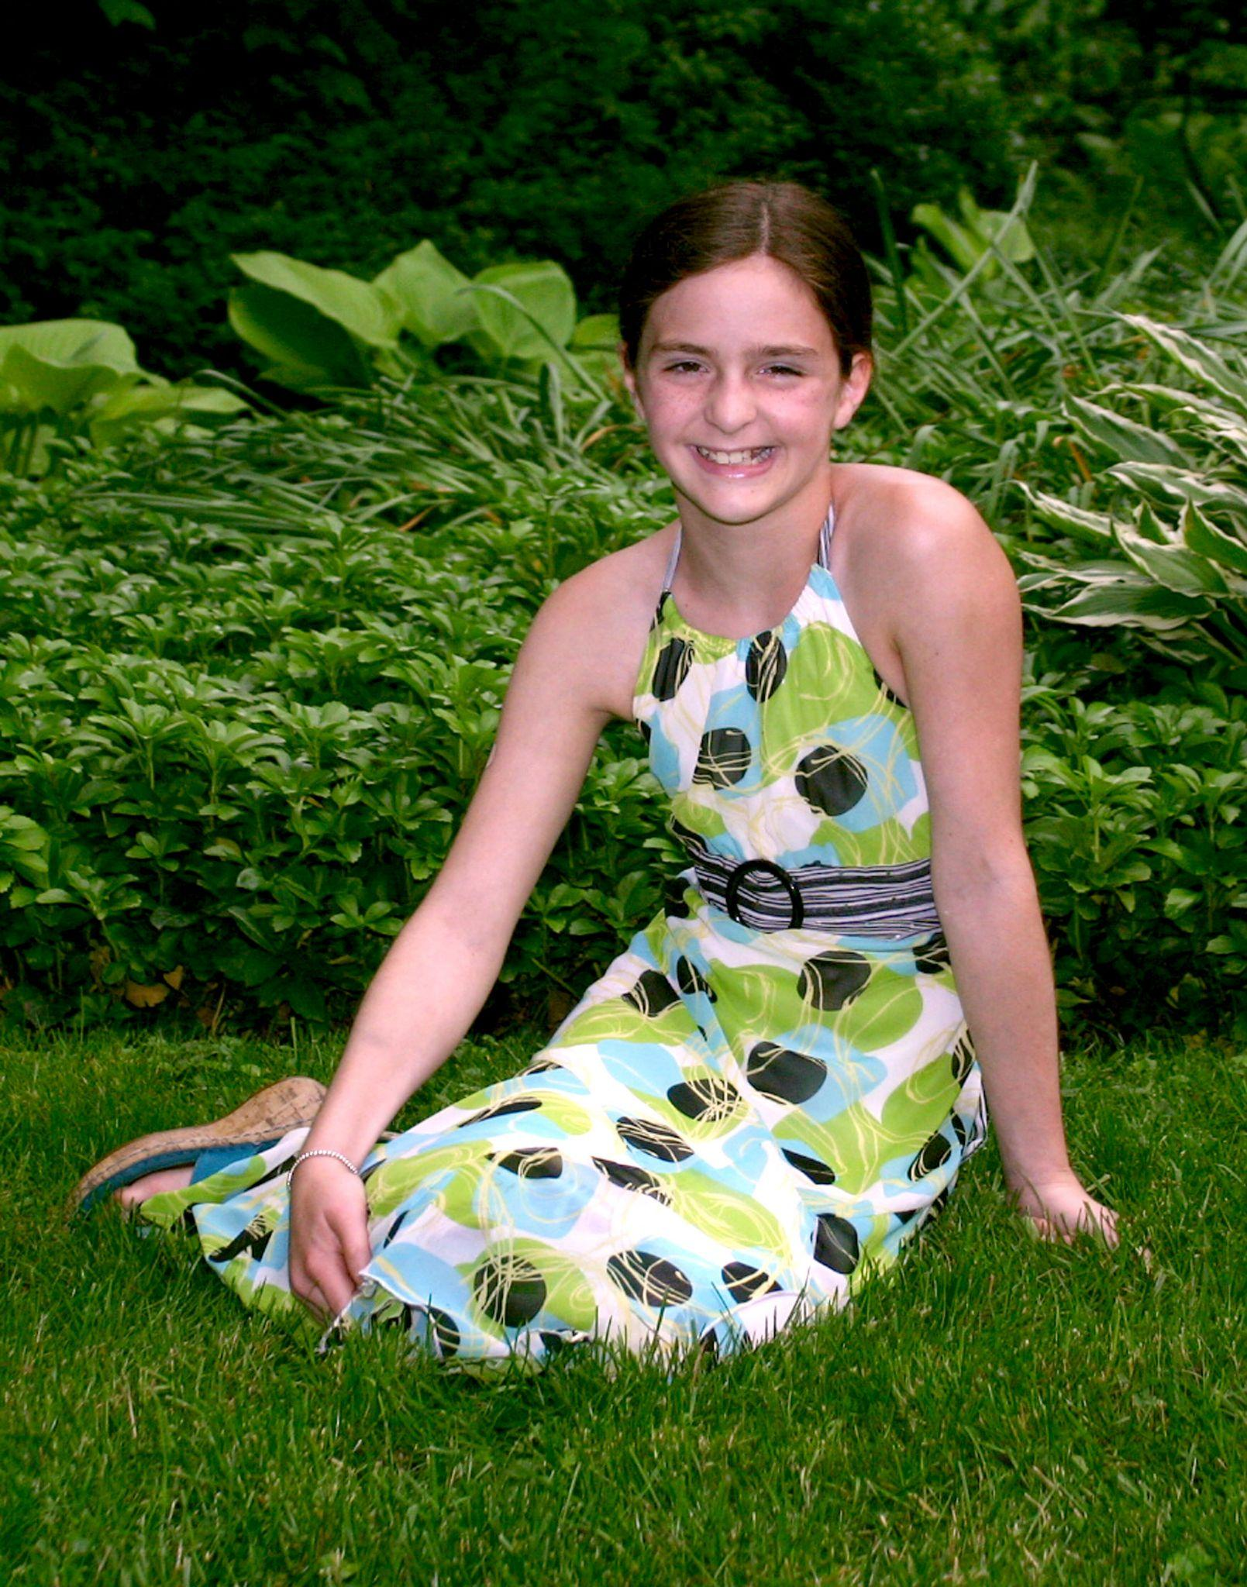
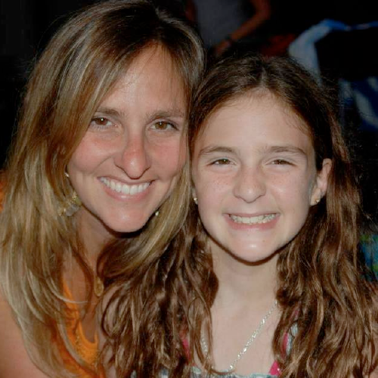
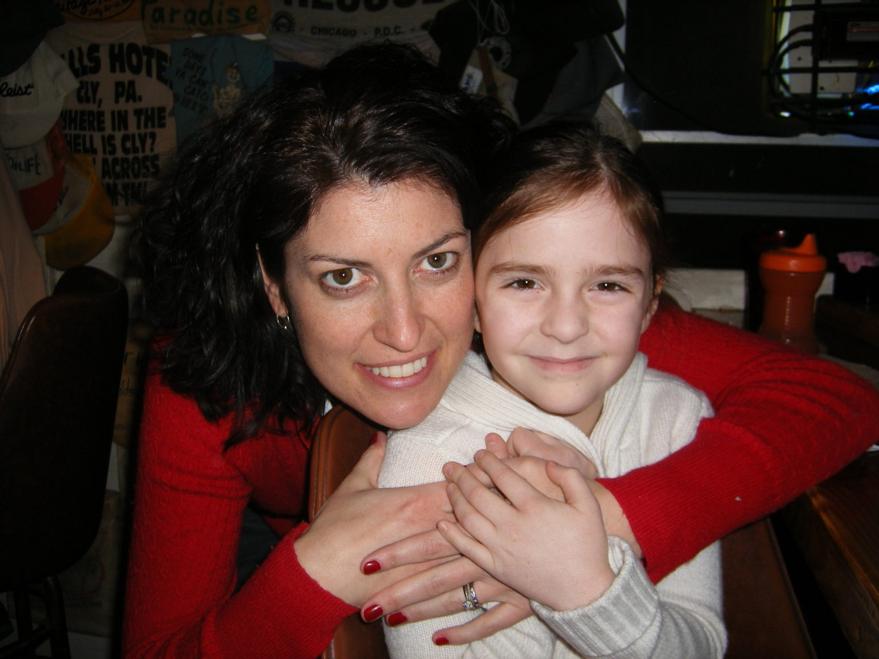
Sam’s Fans
Samantha Jane McCarthy
1998-2009
Notes:
Sam’s Fans was founded in memory of Samantha McCarthy, the daughter of Nikki and Dan McCarthy (my BF from high school). Sam passed away after complications from a bone marrow transplant. Sam loved music and found joy in Music Therapy while undergoing treatment and long hospital stays.

Slide 4
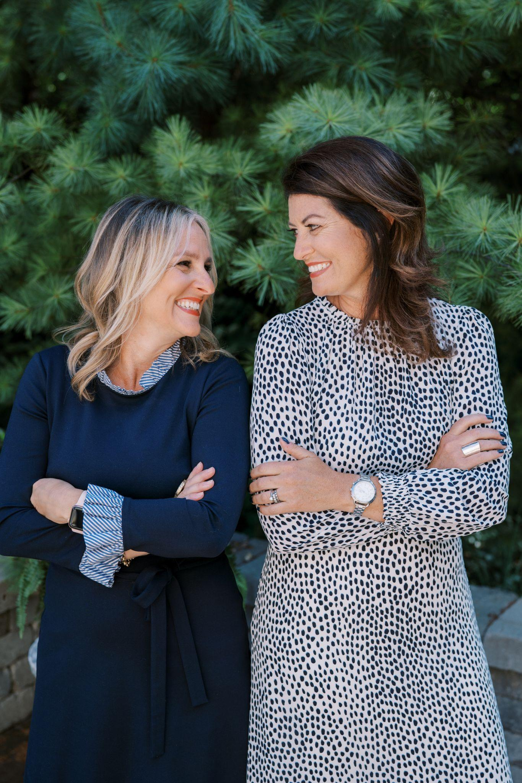
Sam’s Fans: 2015
Personal Experience
Desire to build a legacy for Sam
BA Psychology from Denison University
MBA with focus in Human Services Management
Non-Profit Experience
Notes:
Nikki and I afe BF from high school. Said came to me a few years after Sam had passed away and said she wanted to start a non-profit.

Slide 5
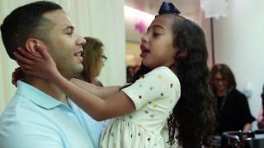
Sam’s Fans: Today Show in 2017
Notes:
This is a video that is an overview of Sam’s Fans. This video was shot in 2017 and so the fundraising information is no longer accurate but the message is the same.

Slide 6
Sam’s Fans: 10 Year Anniversary
Notes:
Sam’s Fans turns 10 this year (April 13th)

Slide 7
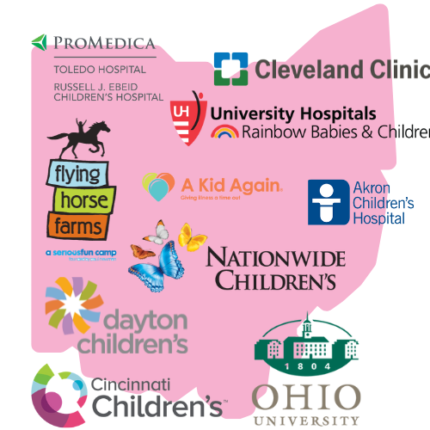
Sam’s Fans: Programs
Notes:
Programs in all 7 Ohio Children’s Hospitals and one in SW Florida, along with other collaborative programs.

Slide 8
Sam’s Fans: Impact
Served over 25,000 children and families
13 Different Programs
Raised over $600,000 in 2024
Goal to fund one full-time position in each Ohio children’s hospital

Slide 9
Sam’s Fans: Impact Stories
Legacy Projects
NICU Babies
End-of-Life Experiences
Stress and Anxiety Reduction
Pain Reduction
Family Interactions
Choice and Control
Notes:
Heartbeat recordings, Thumbprint Necklaces, Guitar Strumming, Music playing in background, Reduces hospital stress, Reduced sedation medications for MRIs, etc, If child is too sick to participate, everyone else can participate, choice adn control: Drs and Nurses always want something. MT and AT dont - they offer choices and jot

Slide 10
Sam’s Fans: Introduction to Data
Hospital Data
Donor Data

Slide 11
Sam’s Fans: Introduction to Data
Hospital Data

Slide 12
Sam’s Fans: Introduction to Data
Donor Data
Giving History, Location, Campaign or Event

Slide 13


Potential Data Goals
Improved Fundraising Strategies
Enhanced Donor Retention & Engagement
Better Decision-Making
Better Resource Allocation

Slide 14
Potential Data Insights
Improved Fundraising Strategies
Donor data helps identify giving trends, preferred donation methods, and the best times to solicit gifts.

Slide 15
Potential Data Insights
Enhanced Donor Retention & Engagement
Help us understand donor behaviors, such as frequency and amount of giving.

Slide 16
Potential Data Insights
Better Decision-Making
Help us prioritize high-value donors, target new donor prospects
Resource Allocation
Help us allocate resources effectively.

Slide 17
Potential Data Insights
What else can you think of?
This is what we are most excited about!

Slide 18
Sam’s Fans: Thank you!
Questions?
mandy@samsfans.org
samsfans.org

